Slide 1
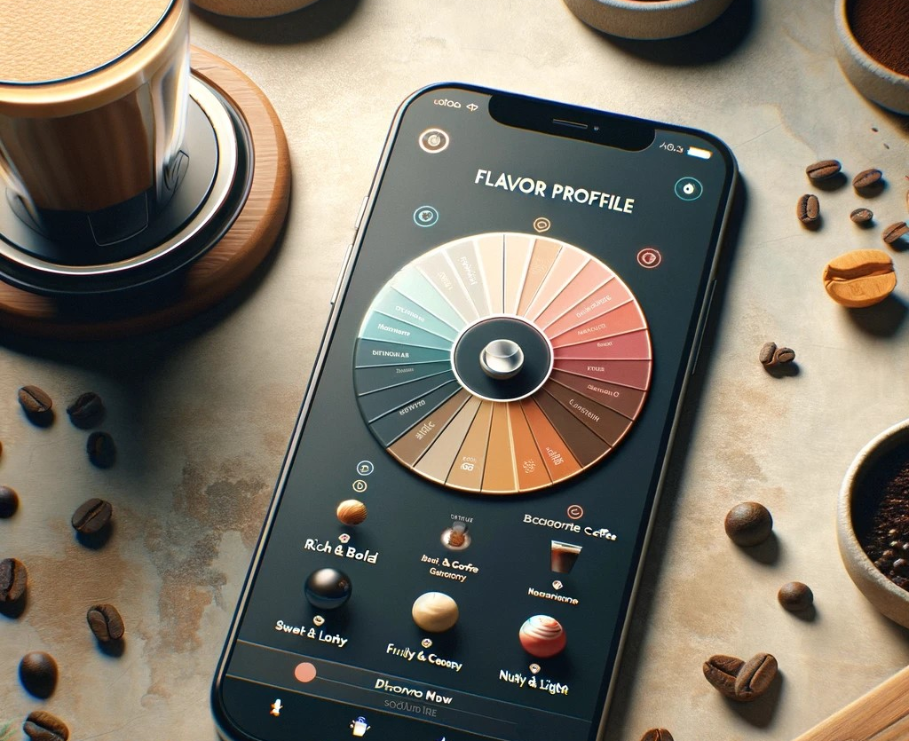
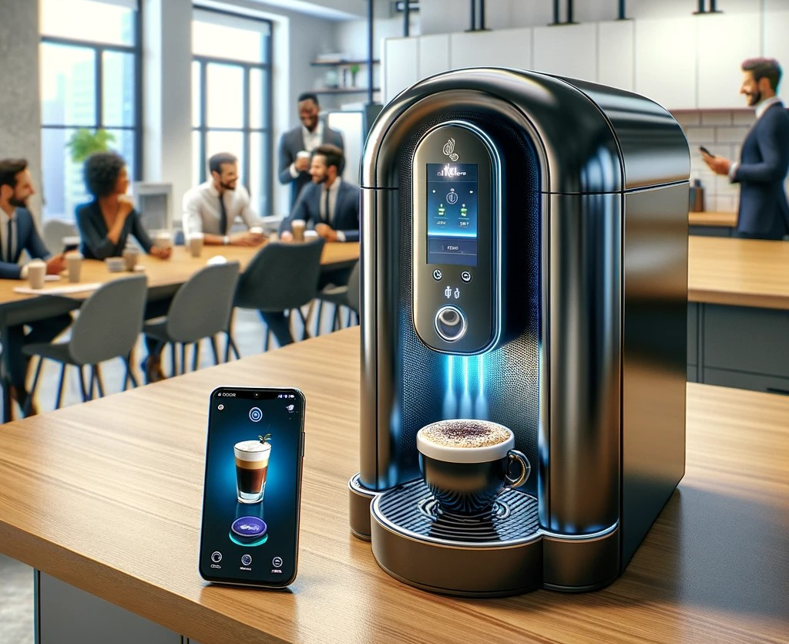
Apex Engineering Java Genie
Your Wish, Our Brew
Problem
Convenient, high-quality espresso and coffee drinks are in short supply
Solution
AI-enhanced All-in-One Espresso & Coffee machine, brings barista-quality coffee to the office break room.
10 Business Owner Interviews

Slide 2
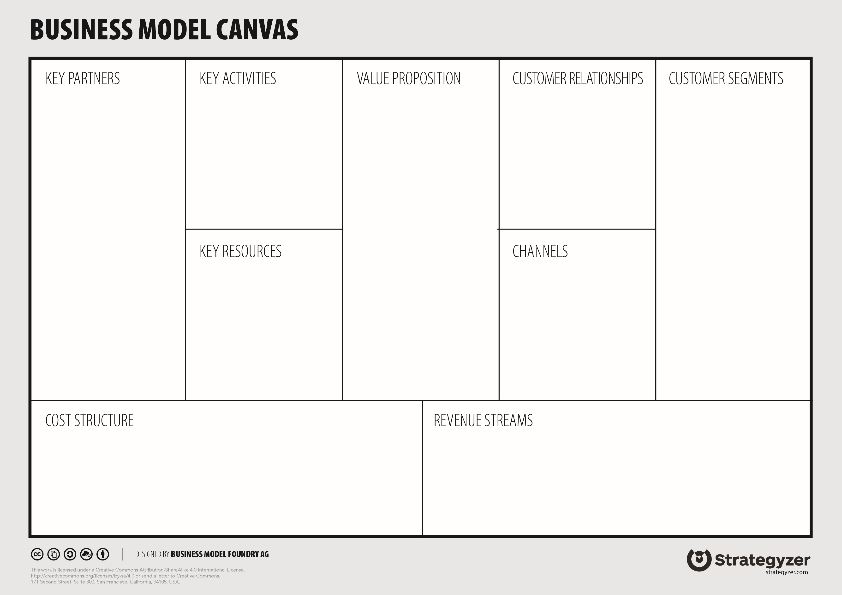
Component suppliers for espresso machine, ice machine, and electronics
Food supplier
Cloud Computing provider, Appstore
Distributors
Appliance Retail Store
Maintenace contractors
R&D - Manufacture all-in-one espresso machine.
R&D - Train AI model on coffee flavors and taste preferences
Sales – Lease machines
Personalized gourmet coffee, hot & iced
Help our customers provide better working environment for their employees = more productive workforce
Flavor Profiles collect user preferences to make better coffee
Convenience to save time and money going to café with barista-level quality coffee in the office breakroom
Monthly lease invoice
Printed name on cup
Unique flavor profiles remember how you like your coffee
Corporate America: Business Owners & Office Administrators looking to increase employee satisfaction
Businesses with simple coffee maker in the breakroom, looking for barista level quality
Offices that are located far away from cafes
Catering companies for events and conferences
HR: AI Engineers, Software Developers, Mechanical Engineers, Culinary Experts, Sales, Marketing, Admins
Prototyping Facility, coffee beans, coffee ingredients, supplier network
Machines placed in public areas at work
Sales target office parks for leasing
Catering at business conference
Free samples at grocery stores
Hardware and Software R&D
Hardware maintenance
Business operations / HR / Insurance
Culinary supplies
Leasing machines
Per-cup cost
Percentage of card transactions
Ingredient purchases offer discount with distributors
Notes:
1st slide – Overview (1 min) Introduce Java Genie and team, Valuation
1 - Value prop (Vijay) 1 min
2 – Customer Segments (Vijay) 1 min
3 – Customer Relationship (Vijay) 1 min
4 – Channels (Alec) 1 min
5 – Key Partners (Jay) 1 min
6 – Key Activities (Jay) 1 min
7 – Key Resources (Jay) 1 min
8 – Cost Structure (Landon) 1 min
9 – Revenue (Landon) 1 min

